Slide 1
Network Design for Shopping Complex
BY: Tanmay Chakrabarty (RA2011003010393) | Adarsh Mamgain (RA2011003010381)
Akshat Naruka (RA2011003010390) | Aditya Mittal (RA2011003010384)

Slide 2
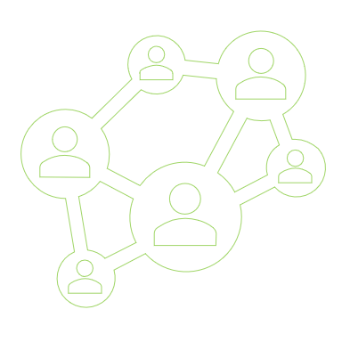
Abstract
Computer networks have a significant impact on the working of an organization. Shopping Complexes nowadays depend on the proper functioning and analysis of their networks for payment, billing/invoices, communication, helpdesk services, checking availability of items etc. An efficient network is essential to facilitate the systematic and cost-efficient transfer of information in an organization in the form of messages, files, and resources. The project provides insights into various concepts such as topology design, IP address configuration, and how to send information in the form of packets to the wireless networks of different areas of a shopping complex.
The aim of this project is to design the topology of the shopping complex network using the software Cisco Packet Tracer with the implementation of wireless networking systems. This network consists of the following devices: 1) Router (Generic) 2) Switches (Generic) 3) Wireless Router 4) Tablets 5) Smartphones 6) Copper straight through cable 7) Serial DTE cable

Slide 3
Why do this?
With an increase in the development of technology the entire world is moving towards the digital era. Hence the shops should adapt to digital means of networking as well and become a “digital complex”. Going wireless plays an important role in this digitalization. The wireless network makes the connection easy with a reduction in the use of wires or cables. A wired connection makes it difficult to keep track of all the devices and to manage the cable connection, which is not only chaotic but also challenging to handle. Complex networking via wireless connection becomes an important part of shopping and provides the main way for buyers and sellers to access the market. As smartphones and intelligent terminals are widely used, demand for access to information anytime and anywhere has become more and more urgent, but traditional cable networks cannot meet this requirement. Then wireless network construction becomes necessary and essential. This is an important mark of the modern shopping stores as a supplement of a cable network. With the development of network and communication technology, cable networks in a shopping complex bring much convenience for communication and shopping process. But for mobility and flexibility, it has obvious shortcomings. A wireless network can overcome these drawbacks and has been applied to the complex.

Slide 4
The Problem Statement
In this mini project, we defined a simulation of a shopping complex network based on wired and wireless networking. The network is divided into five parts i.e., the five floors, Helpdesk, Groceries, Kids, Men's and Women’s wear respectively. The major aim of this project is to show the network connectivity that is used in shops to make the network efficient. The complex network provides different services such as shopping facilities, payment facilities, billing/invoice, checking availability of an item and a helpdesk for additional queries, so it needs wireless networking for smooth processing

Slide 5
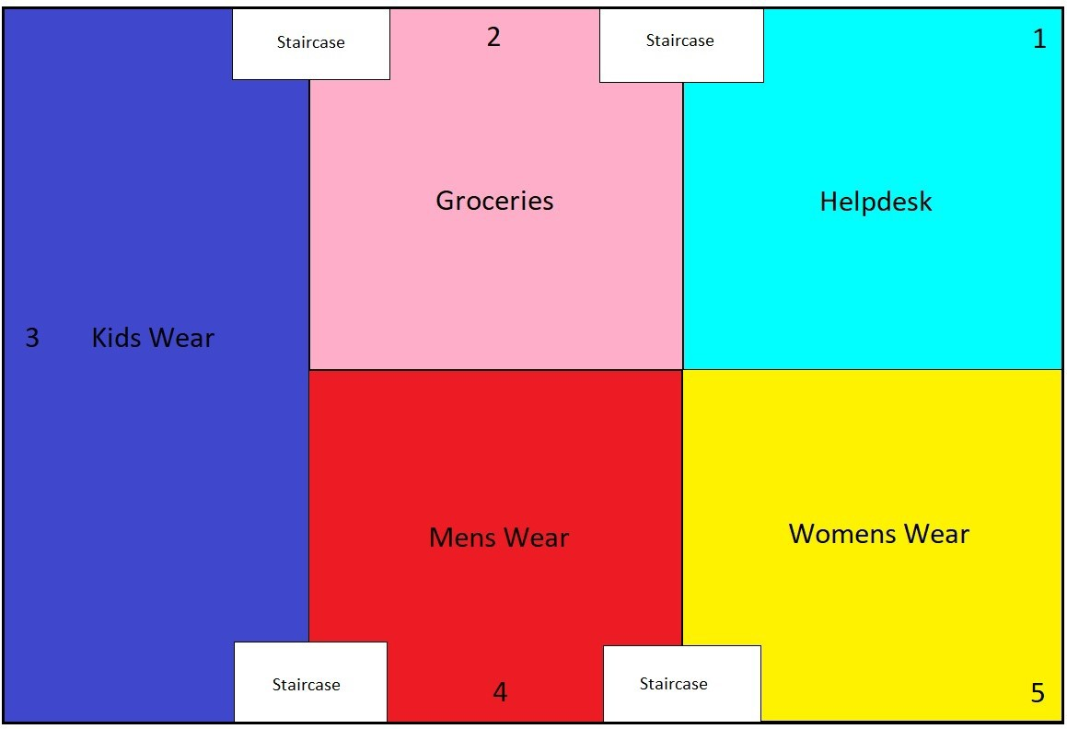
Campus Diagram

Slide 6
Requirements
A proper workstation (any mid-high range laptop will suffice).
Packet Tracer by Cisco
8 GB RAM.
Any 10,000+ Average CPU Mark scored processor.
16 GB of dedicated hard disk space.
USB 3.0+ port
Device | Quantity
Router-PT | 06
Switch-PT | 05
Smartphones | 05
Tablets | 03
Wireless routers | 15

Slide 7
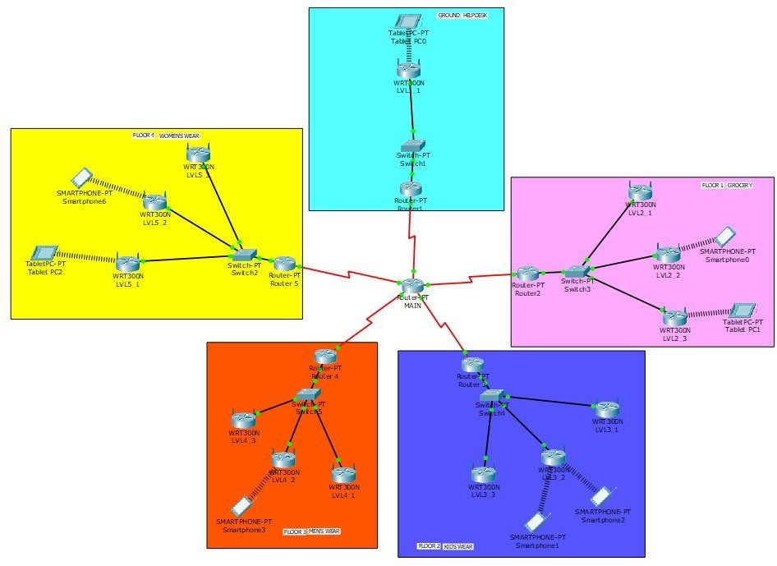
Network Diagram

Slide 8
Network Integration Method
The most common integration process is the Application Programming Interface (API). While there are several API subcategories, including public, private, and partners, they all utilize application integration. By establishing these interconnections using common code language, systems can transmit data seamlessly
Advantages: -
Flexibility - By using product code language, the API method can handle most data variations.
Smooth Operations - The links between the systems allow providers to handle individual connections without disturbing third-party software.
High Availability - As the most common integration strategy, API is available for almost every integration project.

Slide 9
Cost and Other finances
Device | Quantity | Cost(per piece) | Total Cost
Router | 6 | 2829 | 16974
Switch | 5 | 1800 | 9000
Smartphones | 5 | 3999 | 19995
Tablets | 3 | 11999 | 35997
Wireless routers (WRT300N) | 15 | 3500 | 52200
Copper Straight Through | 18 | 500 | 9000
Serial DTE | 5 | 1570 | 7850

Slide 10
Conclusion
In this project we have successfully created Multi level shopping complex network system using Cisco Packet Tracer Where we have created a prototype model for 5 floors where all the floors are connected with one network. This will help shopping complex staffs for the communication and for creating & managing database and financial data.

